Slide 1
BINARY CALCULATOR
A SY MINI PROJECT BY ROHAAN ADVANI – MIS: 111903151

Slide 2
AIM OF THE PROJECT:
USING DATA STRUCTURES:
Take input of infinitely large numbers.
Edit these numbers as per user preference.
Perform basic arithmetic operations on these numbers.
Use stack to store operators as per precedence.
Use stack to store operands.
Solve an expression with various operators/operands.

Slide 3
DATA STRUCTURES USED:
LINKED LIST
STORING DIGIT IN NODE
STORING NODE IN NUMBER
TOKEN FOR EVALUATION
STACK
STORING INTEGER VALUE OF EXPRESSION
STORING OPERATOR CHAR OF EXPRESSION

Slide 4
FILES OF THE PROJECT:
FOLLOWING ARE THE FILES IN THE PROJECT:
main.c – user interface of calculator which takes input from user.
bigno.c – provides structure of linked list in which number is stored digit by digit in respective nodes and contains basic DLL operations which are used to update the number as per user preference.
bigno.h – Header file for above .c file.
opr.c – provides arithmetic and scientific functions which we can use to perform operations of numbers in expression.
opr.h – Header file for above .c file.
stc.c – provides structure of stacks in which operators and operands are stored for backend calculations.
stc.h – Header file for above .c file.
Infix.c – backbone of project uses all the above files to do case by case operations on stored numbers.

Slide 5
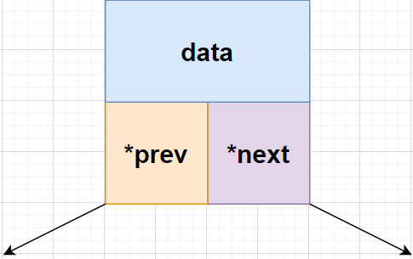
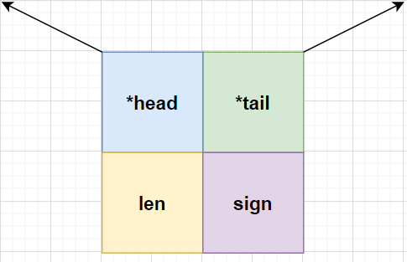
Take input of infinitely large numbers:
Since integer has a maximum limit on how big of a number can be stored in it we need to make a user defined datatype to store a number.
In this project DLL had been used to store a number digit by digit in respective nodes. Structure of a node and structure of a number are as follows:
DIGIT NUMBER

Slide 6
The following is the linked list of the entire number.
*head is the pointer that points to first node of number.
*tail is the pointer that points to last node of number.
Len is the var that stores length of the number.
Dec is the var that stores …
Sign is the variable that stores sign of number:
1 is +’ve and -1 is –’ve.
The above is a node of the DLL which stores single digits.
Data is the digit stored.
*next is the pointer to the next similar node in DLL.
*prev is the pointer to the previous similar node in DLL.

Slide 7
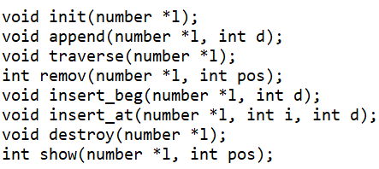
Edit these numbers as per user preference:
Incase of any errors while entering the number the user should have freedom to edit these numbers as per their preference.
Editing the entire number will be a tedious process as we are dealing is large numbers thus functions have been created to initialize, add digits to, remove digits from the number at various positions.
Functions to print the entire number or a digit of the number have also been created in order to display result or make an inference.
bigno.c file contains the following functions in order to perform above editing as per user preference:

Slide 8
FUNCTION
DEFINATIONS:
init() – it is a function that initializes the number to default values.
append() – it is a function which adds entered digit at the end of number.
traverse() – it is a function that prints the entire number.
remov() – it is the function that removes digit from chosen index of number.
insert_beg() – it is the function that adds entered digit at the start of a number.
insert_at() – it is the function that adds entered digit at chosen index of number.
destroy() – function that deletes digit at start of a number.
show() – function that shows digit at chosen index of number.

Slide 9
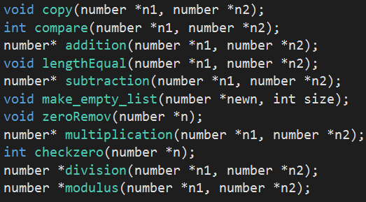
Perform basic arithmetic operations on these numbers:
Basic arithmetic and scientific operations have been performed on the numbers in file opr.c.
Functions include the following:
Addition of numbers
Subtraction of numbers
Multiplication of numbers
Division of numbers
Modulus of numbers
Copy, compare, lengthEqual(), make_empty_list(), zeroRemov() and checkzero() are additional functions used in above operations and in other parts of the program.

Slide 10
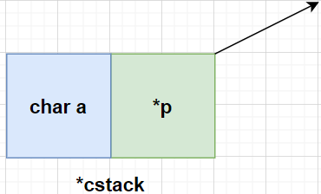
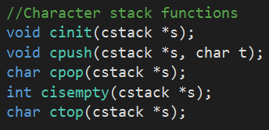
Use stack to store operators:
The character stack is used to store operators.
It has the operator and a self referential pointer for the next operators in the expression.
It stores + , - , * , / , % , ( , ) .
When the expression is being evaluated the topmost operator is popped and used with respective operands.
It has the cinit() function to initialize it.
It has the cpush() function to add an element.
It has the cpop() function to remove an element.
It has the cisEmpty() function to check if stack is empty.
It has the ctop() function to store the topmost operator in a variable.

Slide 11
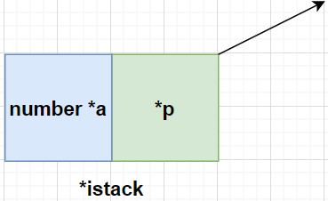
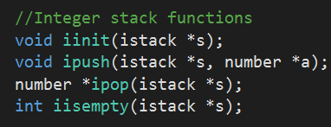
Use stack to store operands:
The integer stack is used to store operands.
Operands are evaluated in order of precedence of operators.
Integer stack contains number and self referential pointer.
It has the iinit() function to initialize it.
It has the ipush() function to add an element.
It has the ipop() function to remove an element.
It has the iisEmpty() function to check if stack is empty.

Slide 12
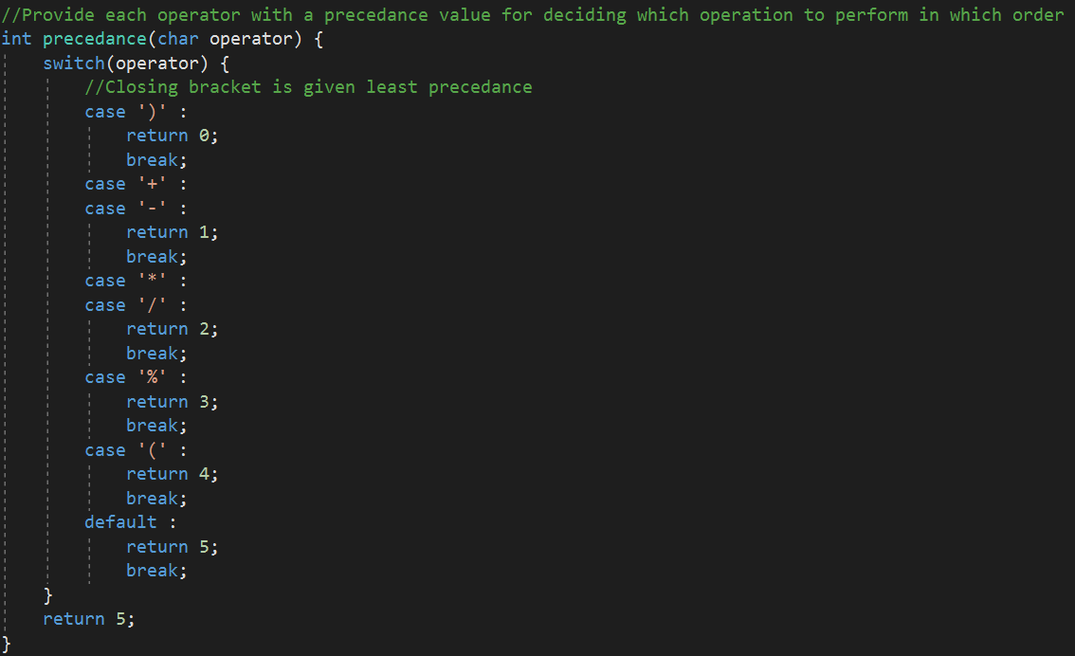
Solve an expression:
Operators are stored in the character stack.
Different operators have different precedence and this function updates their order in the stack and also the order of the corresponding operands so that our evaluation is correct.
As you can see closing brackets has the least precedence which opening brackets has the highest.

Slide 13
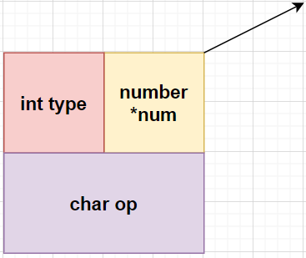
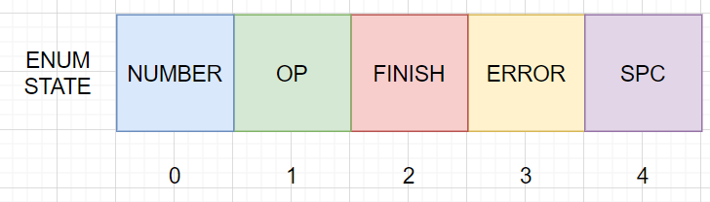
SOLVE AN EXPRESSION:
In the file infix.c there are 2 ADTs:
Token which stores the int type, self referential pointer and operator while evaluation is carried out.
ENUM state which is a user defined data type which provides an integral value to each state so that we can successfully sort the expression before evaluation using the getToken() function.

Slide 14
Solve an expression:
The getToken() function takes input of the expression as a string and it sorts the operators and operands in the integer and character stack respectively token by token through the expression.
It has cases for the current state and subcases for the next state which helps the program decide which state is active and which stack would be used.
It has cases for end, error and space in expression for error handling and thus giving accuracy to the calculator.
Once the entire expression is sorted the control goes to the infix function which is the backbone of the binary calculator.
The infix function first checks for brackets and count of brackets, then it pops top operator and top 2 operands for evaluation.
It evaluates the sub expression and pushes result back to integer stack.
Process is continued until character stack is empty and integer stack thus will have the final result.

Slide 15
CONCLUSION:
USING DATA STRUCTURES WE:
Took input of infinitely large numbers.
Edited these numbers as per user preference.
Performed basic arithmetic operations on these numbers.
Used stack to store operators as per precedence.
Used stack to store operands.
Solved an expression with various operators/operands.

